Slide 1
BLG252E-Object oriented programming
Practice Session 1

Slide 2
What will we cover?
Constructor:
default
with parameters
Dynamic allocation for data members
Copy constructor
Const methods
Destructor

Slide 3
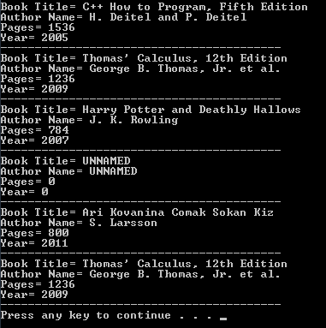
What will we do?
We are going to implement a Book class and then use it in our main program to create an array of books and print their information on the screen like the example on the right.

Slide 4
For Better Modularity
Book class will be implemented in book.h and book.cpp.
book.h is to contain attributes and prototype of methods(header file(.h) → declaration)
book.cpp is to contain method bodies (source file(.cpp) → the code to be used runtime)
And there will be a main program(PracticeSession1.cpp) to use and test the Book class.

Slide 5
book.h
First, we will prepare the header file “book.h” containing the attributes and method prototypes of the Book class.
The structure of the header file will be like below:
// to include the header once
#ifndef BOOK_H
#define BOOK_H
// class definition will be here
#endif

Slide 6
book.h: Data Members
Data members are listed below:
char *itstitle; //Title of the book
char *itsauthorname; //Author name of the book
int itsyear; //Publishing year of the book
int itspages; //Number of pages of the book

Slide 7
book.h: Constructors and Destructor
Default constructor:
Book(); //Initialize itstitle and itsauthorname as “UNNAMED”, itsyear and itspages as 0.
Constructor with input parameters:
Book(const char* title, const char* authorname, int year, int pages); //Initialize data members by using given input
Destructor:
~Book();//Destruct the necessary object members

Slide 8
book.h: Copy Constructor
Copy constructor:
Book(const Book& book_to_copy); //Initialize data members by copying the information of another Book object
Why do we define the input parameter of a copy constructor by using const?

Slide 9
book.h: Methods
Necessary methods are described below:
setTitle, setAuthorName, setYear, setPages: to set the itstitle, itsauthorname, itsyear and itspages data members.
getTitle, getAuthorName, getYear, getPages: to access the itstitle, itsauthorname, itsyear and itspages data members.

Slide 10
book.cpp: Source code containing bodies of constructors, destructor and methods.
In “book.cpp”, we will write the bodies of constructors, destructor and methods declared in “book.h” header file.

Slide 11
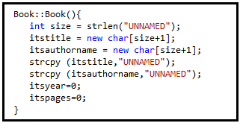
book.cpp: Body of constructors
Default constructor:

Slide 12
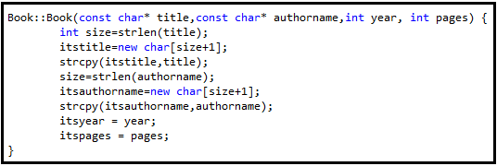
book.cpp: Body of constructors
Constructor with parameters:

Slide 13
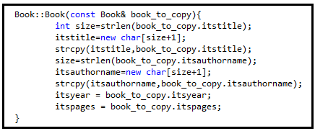
book.cpp: Body of constructors
Copy constructor:

Slide 14

book.cpp: Body of destructor
Destructor: We need to use a destructor for the Book class as itstitle and itsauthorname attributes are dynamically allocated.

Slide 15
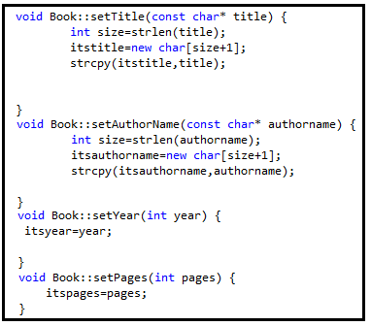
book.cpp: Body of setTitle, setAuthorName, setYear, setPages methods
These methods can both be used for initializing data members after creation of the object by using the default constructor and changing the values of data member.

Slide 16
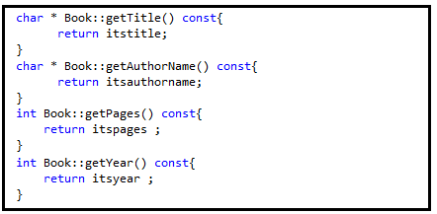
book.cpp: Body of getTitle, getAuthorName, getYear, getPages methods
As these methods are not for changing the values of data members of the class, we declare them as const methods.

Slide 17
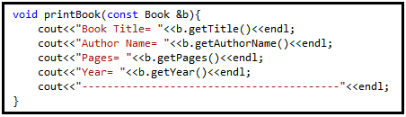
PracticeSession1.cpp: Program to test Book class
Here we define a function named printBook which takes a reference to a Book object as input parameter and prints the data members of the object on the screen.
In the main function, we create an array of Book objects named as bookArray , an uninitialized book object b1, a book object b2 which is initialized by using the constructor with parameters and a book object b3 which is exactly the same as bookArray[1].

Slide 18
PracticeSession1.cpp: Program to test Book class
By using printBook function for the elements of bookArray, b1,b2 and b3, we get an output like:

